Slide 1

UNIVERSITI TEKNOLOGI MALAYSIA
SECP3623 - DATABASE PROGRAMMING
2025/2026 - SEM 1
Lab Assignment 1 (5%) - Indexes
Name | : | SYARIFAH DANIA BINTI SYED ABU BAKAR
Matric Id | : | A23CS0183
Name | : | AIN NURNABILA BINTI MOHD AZHAR
Matric Id | : | A23CS0207
Name | : | NURUL ADRIANA BINTI KAMAL JEFRI
Matric Id | : | A23CS0258

Slide 2

UNIVERSITI TEKNOLOGI MALAYSIA
BITMAP INDEXES
by Nabati Strawberry

Slide 3
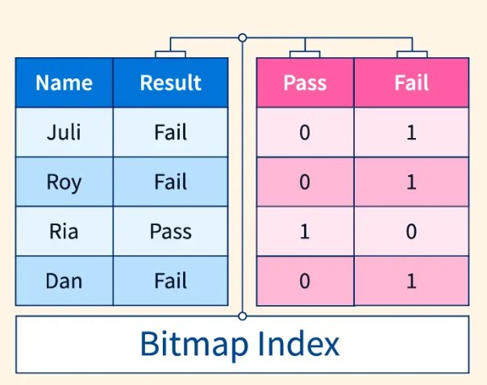
INTRODUCTION
​​
MySQL Workbench does not support bitmap indexes. Therefore,
BTREE indexes were applied on low-cardinality columns which are 'gender', and 'status to simulate bitmap behavior.​
Bitmap indexes are typically used in analytical databases such as in Oracle.

Slide 4

Database Creation
This figure shows the creation of a new database named index_lab, which will store the student table and related indexes.

Slide 5
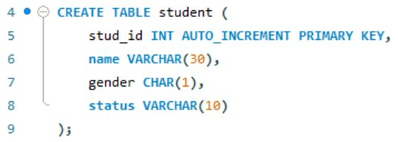
Table Creation
The student table is created with columns suitable for testing
bitmap index concepts. The gender and status fields are low-
cardinality attributes, making them ideal for demonstrating bitmap
indexing.

Slide 6
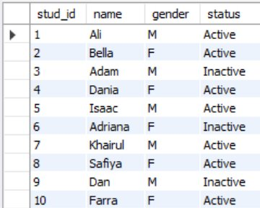
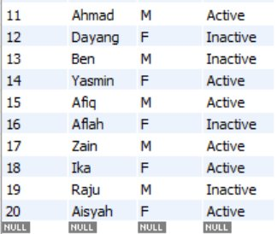
Insert Sample Data​
Twenty sample rows are inserted with a mix of male/female and
active/inactive values. These records simulate real-world data where
bitmap indexes can optimize filtering on repeated categories.

Slide 7

Create Bitmap-like Indexes​
Two indexes are created on the gender and status columns. Although MySQL uses B-tree indexes, they behave similarly to bitmap indexes for low-cardinality data by enabling faster lookups on these attributes.​
Before Bitmap Indexing​
Time taken to execute​

Slide 8
After Bitmap Indexing​
Time taken to execute​

Slide 9


Run Query Using Index​
This query counts how many female students have active status. With indexes on both columns, MySQL can locate matching rows more efficiently, replicating the effect of bitmap-based filtering operations. ​

Slide 10

Use Explain​
The EXPLAIN output shows how MySQL executes the query. The presence of idx_gender and idx_status in the plan confirms that the indexes are being used to limit the scanned rows, improving query performance.​

Slide 11
Discussion & Reflection​
What is a Bitmap Index?
A bitmap index uses bit arrays (0s and 1s) to represent the existence of a value in each row. It's efficient for columns with few unique values, such as gender or status.​
Advantages of Bitmap Index​
1. Fast for low-cardinality columns (few distinct and unique values).​
2. Efficient for combining multiple conditions (AND, OR).​
3. Saves storage for analytical queries (OLAP systems).​

Slide 12
Discussion & Reflection​
Disadvantages of Bitmap Index​
1. Not ideal for columns that are frequently updated/deleted.​
2. Inefficient for high-cardinality data (many unique values).​
3. Slower performance in OLTP systems with many writes.​
Reflection regarding Bitmap Index​
Bitmap indexes are best suited for data warehouses (OLAP) or read-heavy environments with low-cardinality columns.​
They are not recommended for transaction-heavy databases (OLTP).​

Slide 13
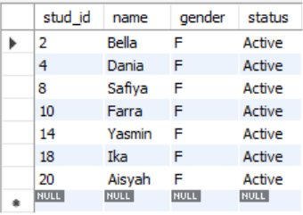
Discussion & Reflection​
Why Bitmap Index are best for low-cardinality columns?​
Because bitmap indexes store values as compact bitmaps, allowing extremely fast filtering and combination of conditions with minimal storage overhead.​
As Example;

Slide 14
Discussion & Reflection​
What happens to Bitmap Indexes during frequent updates/deletes?​
Frequent updates or deletions can cause performance degradation because the database must modify large portions of the bitmap structure, leading to row-level or even table-level locks.​
Resulting in;​
Better performance in OLAP systems (read-heavy environments).​
Slower performance in OLTP systems (many write operations).​

Slide 15


THANK YOU
utmofficial
univteknologimalaysia
utm.my

